Slide 1
Identifying The Most Ideal App Store
Company XYZ

Slide 2
Project at a Glance
Problem:
Company XYZ has developed a new operating system and needs to identify the best apps store to integrate
Objectives:
Identify a dataset to use to represent potential solutions for fit within XYZ’s OS
Analyze data for key statistics
Visual Data
Evaluate potential solutions

Slide 3
Methodology: Sourcing Data
Our company first gathered data from both major apps stores: Google and Apple
Several key areas of information were present in the data
We imported the data using Python’s import function
We chose 4 key statistics to capture: Category, Rating, Reviews, Price

Slide 4
Methodology: Cleaning/Transforming Data
The data included several values that needed to be excluded and cleaned
We ensured the price variable of data was in a numeric value
We moved any erroneous data
We also used a method in our analysis package to merge the data into one file
We ensured our column headings were also matching

Slide 5
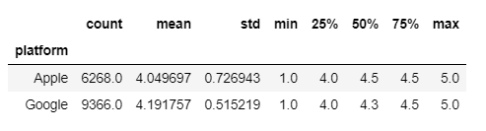
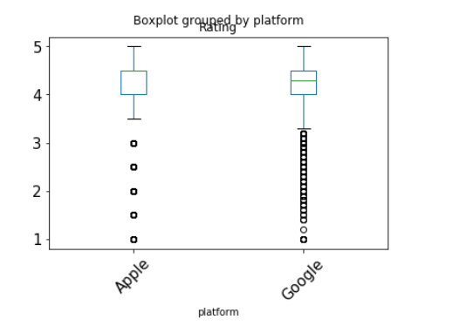
Methodology: Visualizing
After analyzing the data, we identified a summary of statistics based on the “Rating” of each app platform
Note that the mean (average) of the ratings seem to be very close with Google slightly higher
Good also had more ratings vs Apple in this sample.
Our Box Plot shows that Google’s ratings are more gathered slightly higher than Apples, as noted to the right.

Slide 6
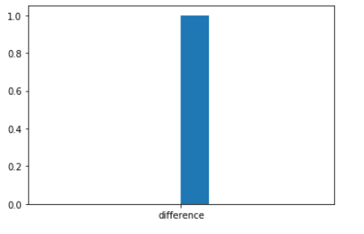
Methodology: Modeling
To ensure our sample actually translated to Google having the higher mean, we modeled the data to ensure that if a random rating was given to each data set, 10,000 times, we should NOT get the same result, meaning Google truly does correlate to a higher rating.
After modeling, one can see that there is a statistically significant correlation of Google’s platform to a higher rating in the app store

Slide 7

Conclusions
Based on our analysis, We conclude that platform does impact on ratings.
Specifically, Company XYZ should integrate only Google Play into their operating system interface.

